Slide 1
GapCon - Intro
High tech –
cost efficient –
trouble free

Slide 2

agenda
Introduction of GapCon
Group and Group Structure
Product Portfolio
Nonwoven

Slide 3
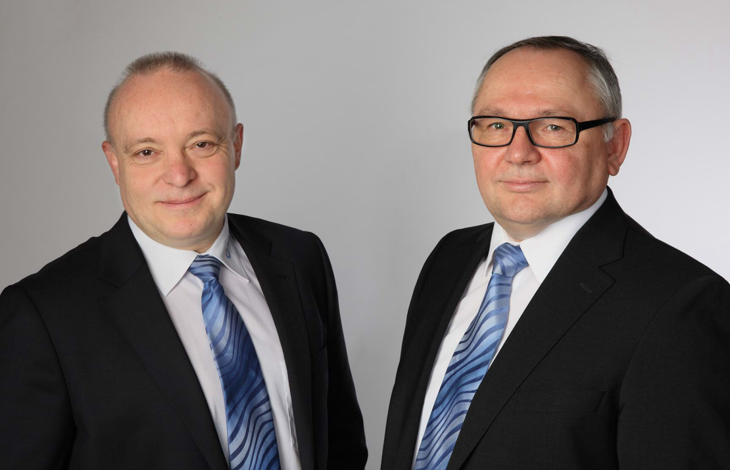

Introduction
The two acting Partners
Wolfgang Wiertz
Wolfgang Mark
Master Degree in Mechanical Engineering
1986 – 1999 Eduard Küsters GmbH & Co.KG
(Head of Engineering, COO)
2000 – 2006 Walzen Irle GmbH
(Head of Sales and MD SIWACO)
Master Degree in Mechanical Engineering
1987 – 2006 Eduard Küsters GmbH & Co.KG
(Director Engineering & Development)
Founded GapCon GmbH in 2006

Slide 4
Introduction
Commercial Data
Head Office: Willich (GER, near Düsseldorf)
Year of Establishment: January 2006
Shareholder: Wolfgang Wiertz, 10% Wolfgang Mark, 10% Irle Deuz GmbH, 80%
Sales: 15 Mio EUR (2010) 28 Mio EUR (2011) 32 Mio EUR (2012-Group)
41 Mio EUR (2103-Group)
Type of Company: GmbH, private limited company
Managing Directors: Wolfgang Wiertz & Wolfgang Mark

Slide 5
agenda
Introduction of GapCon
Group and Group Structure
Product Portfolio
Nonwoven

Slide 6





Group Structure
GapCon , in a strong environment
100%
100%
80%
55%

Slide 7

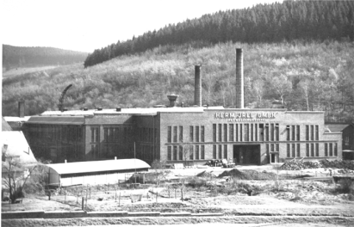
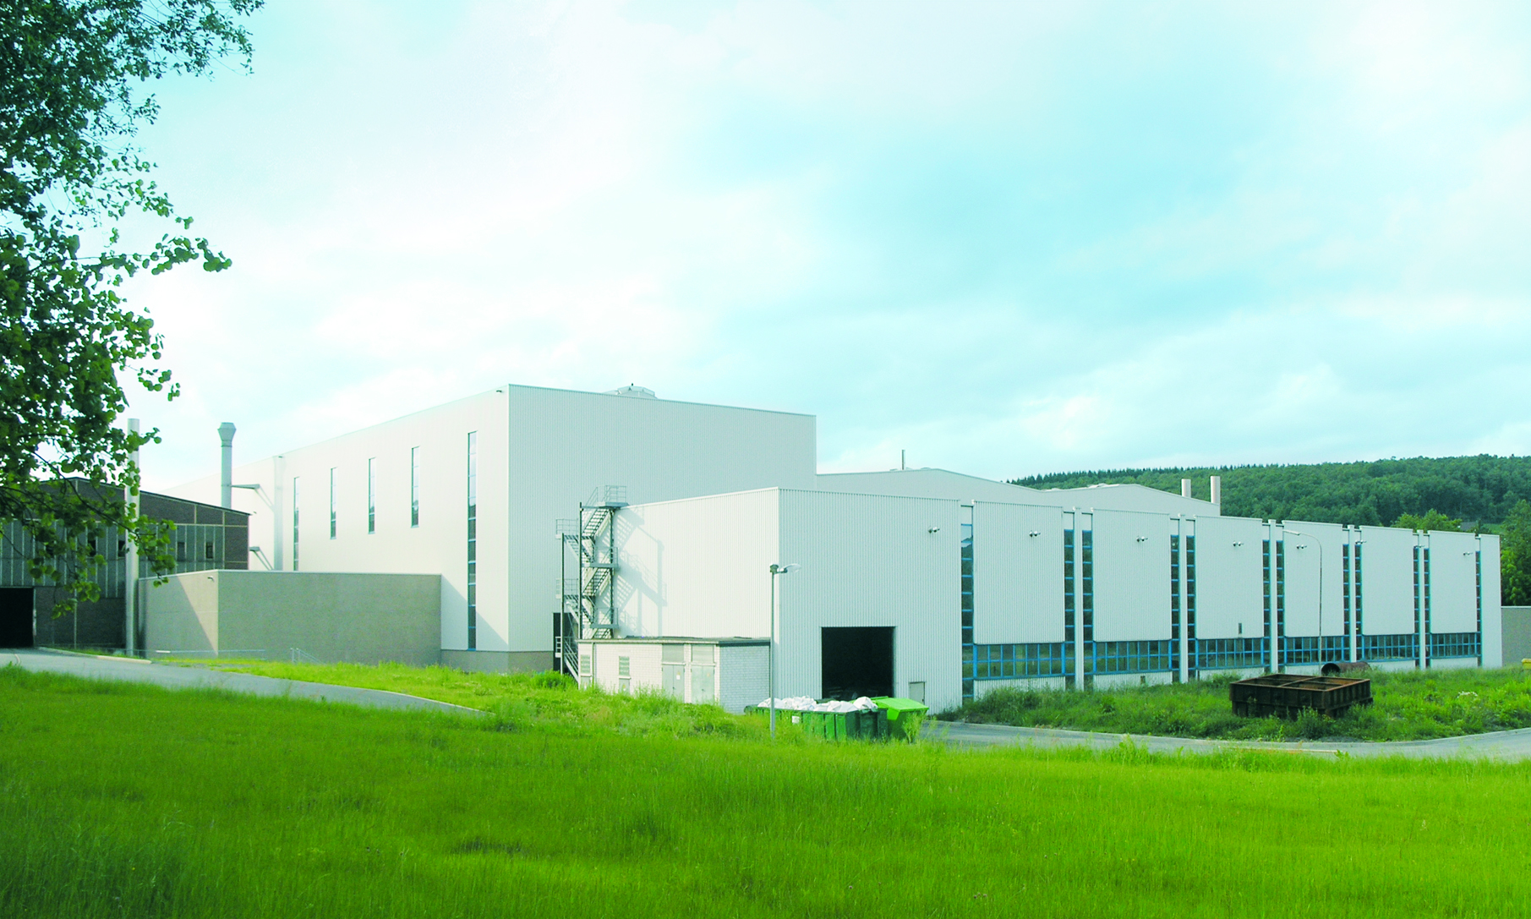
GapCon Group
History
Since 1693 specialized in casting technology
Since 1820 casting of rolls (steel rolls)

Slide 8
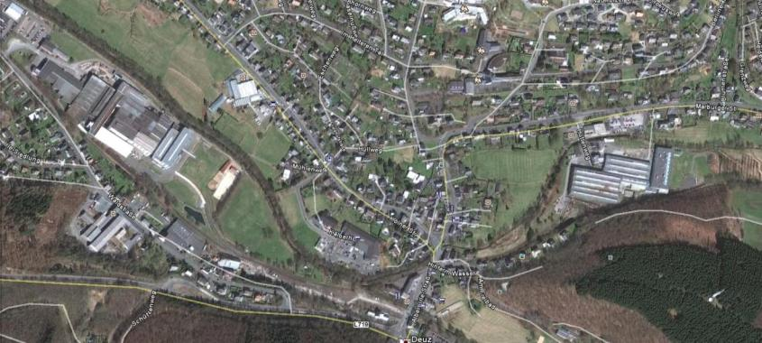
Introduction
GapCon - Irle Deuz
Irle Deuz / Walzen Irle: Nethen Deuz; 100 km East of Cologne
Foundry and Machine Shop in the same town, but in different locations

Slide 9
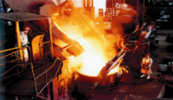
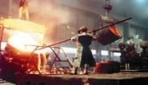
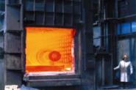
Introduction
GapCon - Irle Deuz
Walzen Irle
50 Mio EUR average turn-over past 2 years
250 employees
Key products
Rolls for the Paper Industry
Heavy Plate Mill Rolls
Work rolls for flat strip steel mills
Sectional rolls for various kind of long products
Wear resistant castings
Castor castings → possible investment

Slide 10
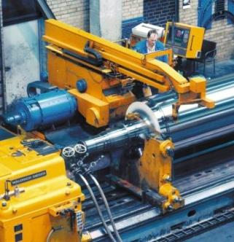
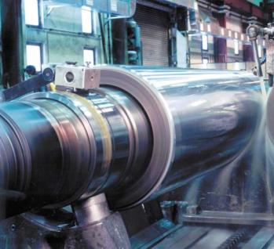
GapCon Group
Production Capacity:
normal capacity 1.200 t finished
products per month
production data:
face length: up to 13 m,
finished diameter: up to 1,5 m
finished weight: up to 100 t
More than 60 CNC machines:
turning, milling, drilling, boring,
honing, grinding and balancing in
12 machine floors!

Slide 11
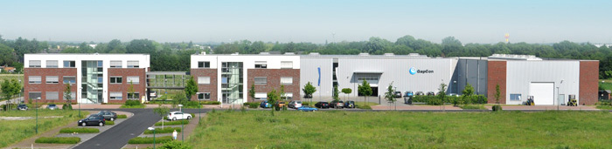
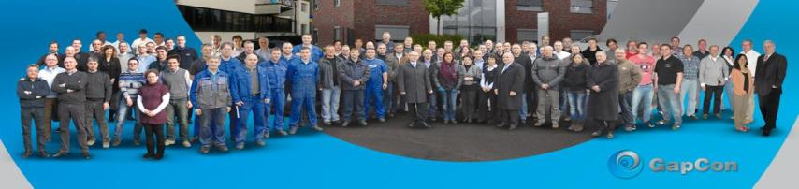
GapCon Today
GapCon Willich location
GapCon completed another extension project end 2012

Slide 12
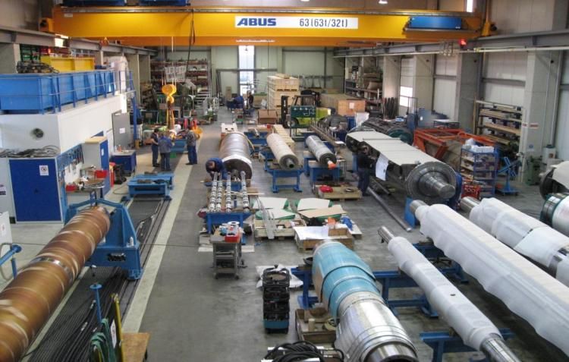
GapCon Today
GapCon Willich - our workshop and roll test bench

Slide 13





GapCon Today
GapCon Group Structure
Paper Experts
Sales 13
Technology & Design 56
Automation 12
Service 13
Workshop 21 115
GmbH Willich
80%
100%
95%
100%
Engineering Pvt. Ltd.
Kolkatta
India
04/2009
Machinery Ltd.
Shanghai
China
02/2011
S.r.l.
Pescantina
Italy
01/2012
GmbH
Willich
Germany
01/2012

Slide 14
GapCon Today
GapCon - Development of Sales & EBT

Slide 15
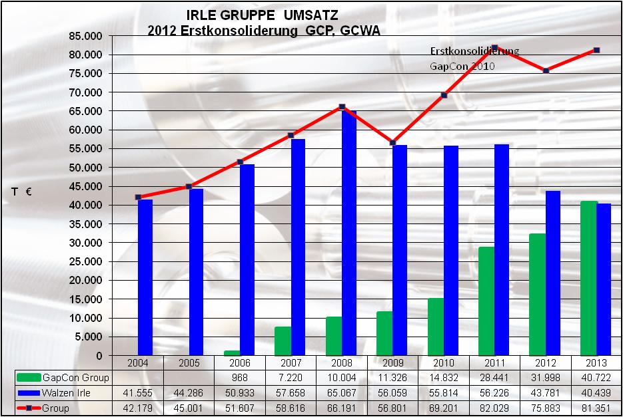
GapCon Today
GapCon - Irle Deuz

Slide 16
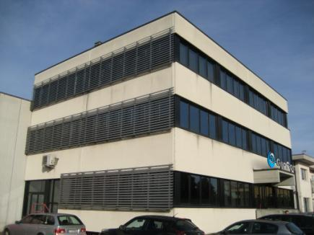
GapCon Today
GapCon S.r.l. - Pescantina
GapCon engineers/manuf. key components for paper machines in it’s subsidiary in Italy
Center of Excellence for:
Headboxes
Top former
Presses
Pope Reels
Machine Upgrades
Tissue Machines

Slide 17
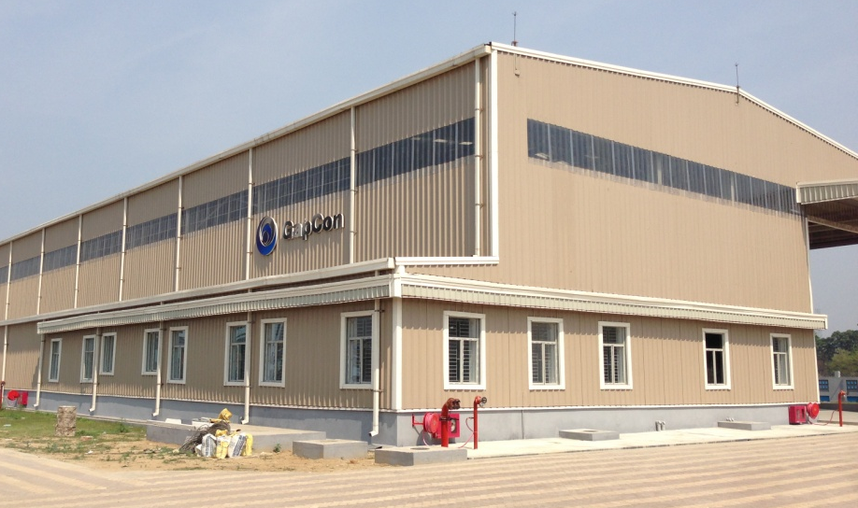
GapCon Today
GapCon Engineering Pvt. Ltd. – Kalyani
(NEW Roll Service Center - operational since January 2014)
Scope:
Roll grinding of all kind of rolls
Roll repairs and balancing
Assembly of equipment for local market
Engineering services
Base for field service

Slide 18
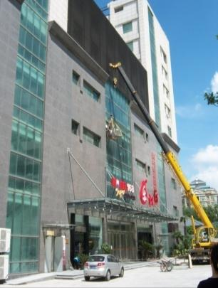
GapCon Today
GapCon Machinery (Shanghai) Co. Ltd, China
Sales & Service Organization
GCS is capable to manufacture and trade
GCS is ready to take up the challenge any minute
Office + rented shop
4 Employees
German Manager

Slide 19
agenda
Introduction of GapCon
Group and Group Structure
Product Portfolio
Nonwoven

Slide 20
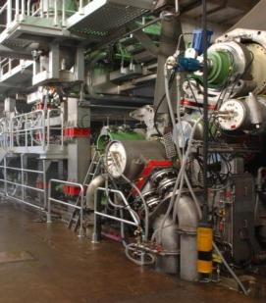
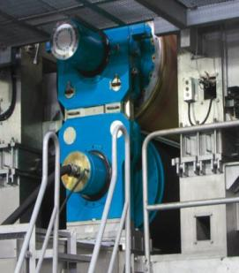
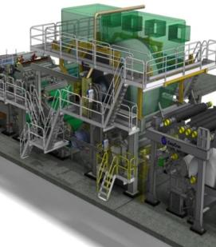
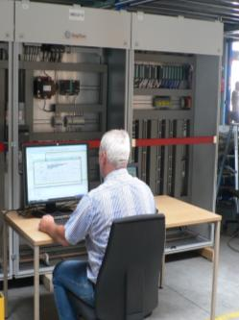
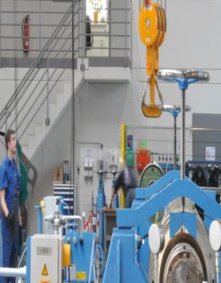
Products Paper
Key Components
Head Box
Top Former
Shoe Press
Film Press
Calender
Pope Reel
Winder
PM Upgrades
Tissue
Automation
Service

Slide 21
agenda
Introduction of GapCon
Group and Group Structure
Product Portfolio
Nonwoven

Slide 22
Nonwoven
Portfolio
1. New Calenders
2. Calender Rebuilds & Upgrades
3. Roll Upgrades & Service
4. Spare Rolls
5. Supply of spare parts
6. Consulting and system audits

Slide 23
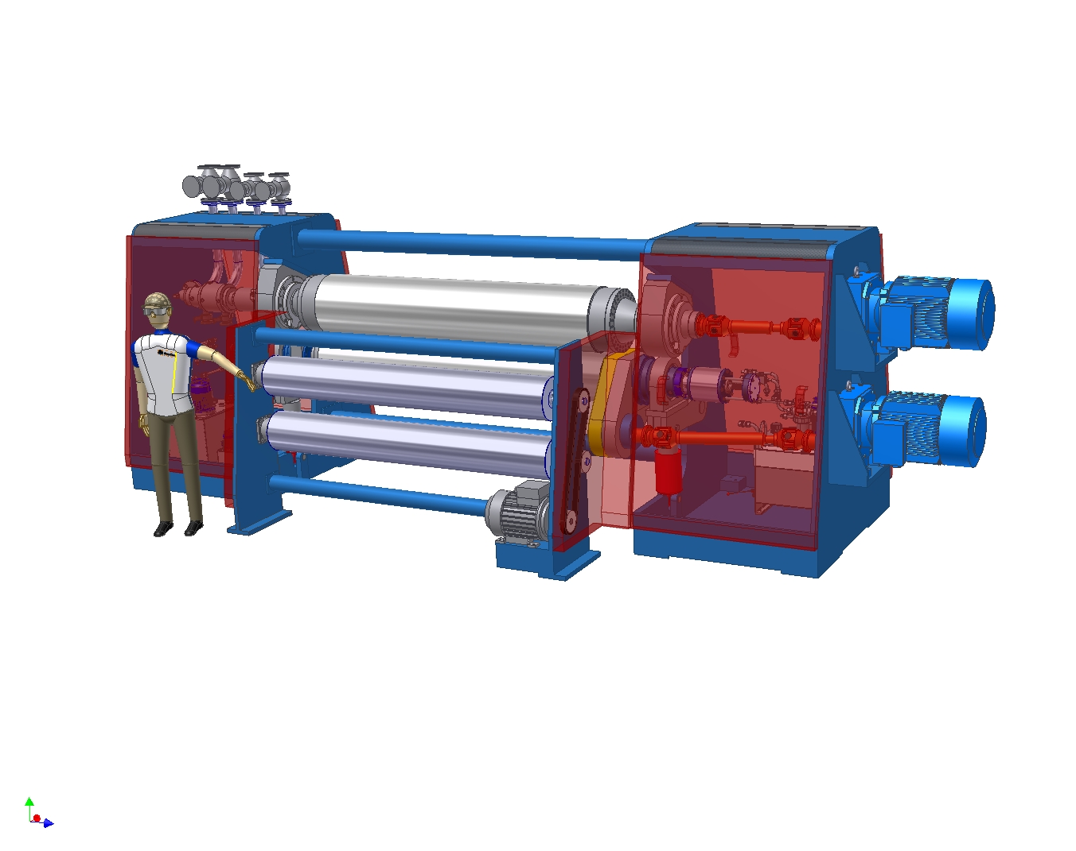
Nonwoven
Calender Concept
Modular system
Sandwich concept; separate frame units on TS & DS
Ready assembled, piped and wired
Centralized connection points; easy to install
Beams utilized for piping connections TS/DS
1x2 EconPro™ Calender

Slide 24
Nonwoven
Calender Concept
1x2 EconPro™ Tandem Calender
Two Engraving Roll to change design on the run!
Combined moving/loading cylinders

Slide 25

EconPro™ Tandem Calender
existing concept
GapCon concept

Slide 26
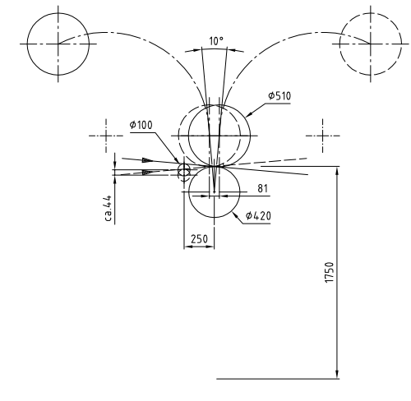
EconPro™ Tandem

Slide 27
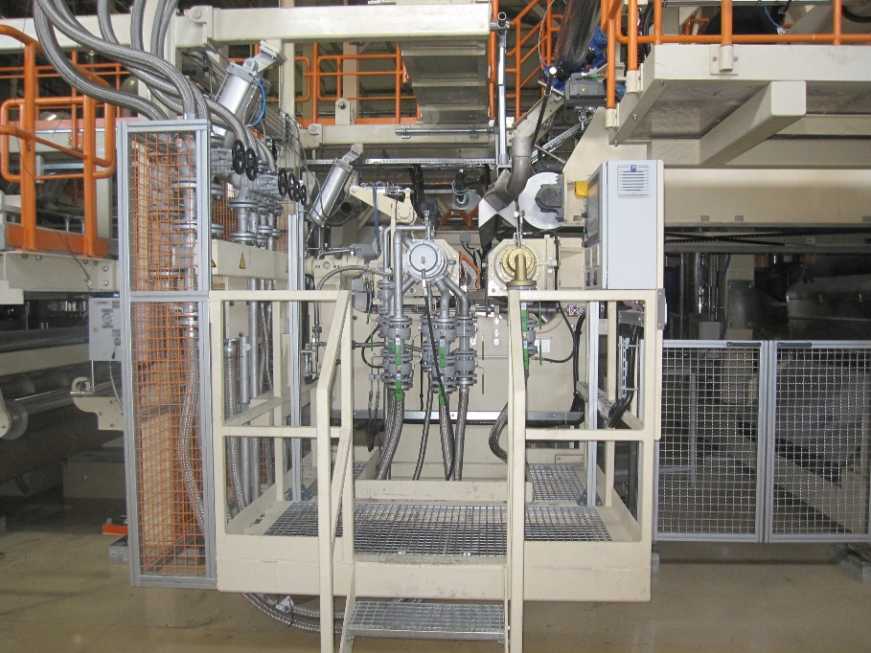
Nonwoven
1 x 2 EconCAL Calender
Airlaid Product
30-300 gsm
1700 mm
400 m/min
250°C

Slide 28
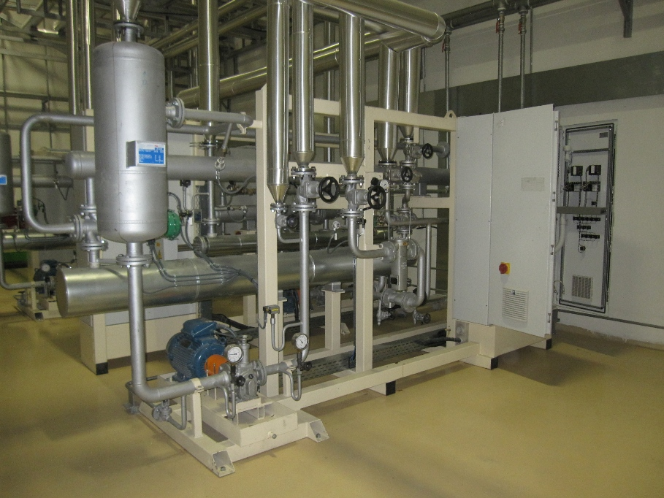
Nonwoven
Oel Heating System for Calender
Electrical Oil heating system for
Engraving Roll &
EconROLL™ HT

Slide 29
Nonwoven
Roll Family
EconROLL™ HT 200 Hot swimming roll
EconROLL™ CS 200 Hot swimming roll – gap
EconROLL™ HT 250 Superior hot swimming roll
EconROLL™ VT 250 Engraving roll

Slide 30
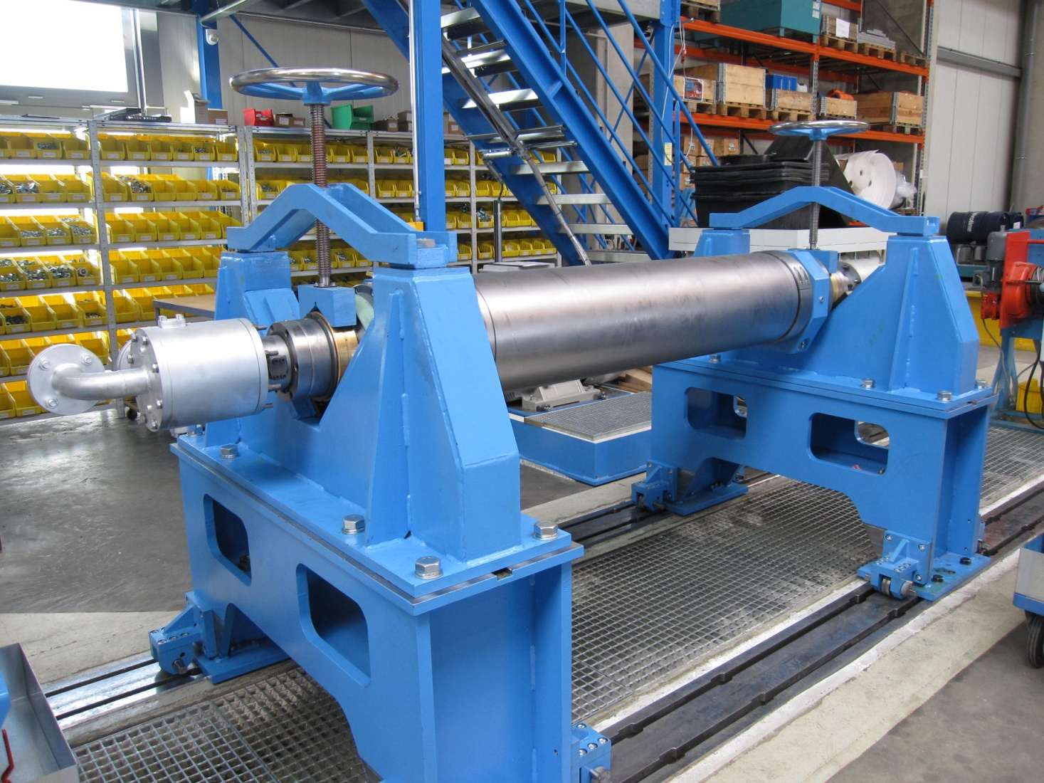
Nonwoven
Roll Family
EconROLL™ HT 250 – ready for testing
Ø 355 x 1500 mm face width

Slide 31
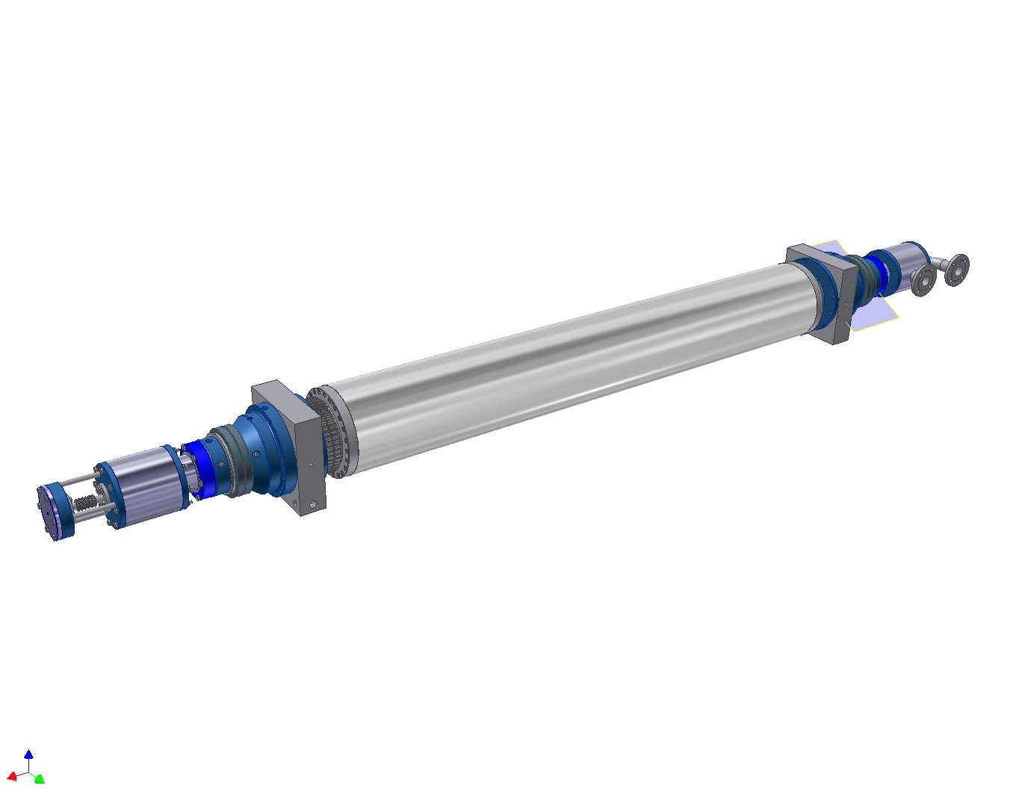
Nonwoven
EconROLL HT 250
The superior swimming roll for high temperature applications!
swimming Roll designed for high temperature
Oil temperature limited to 280°C
Driven by a chain wheel
Equipped with TwinSeal

Slide 32
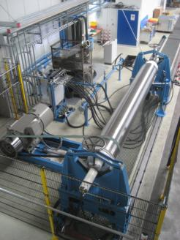
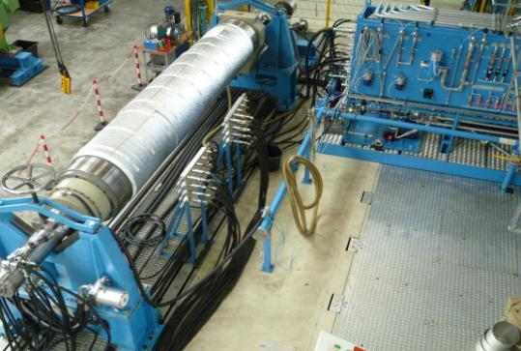
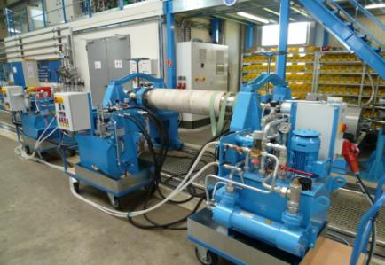

Nonwoven
Test bench for hot swimming rolls
Rolls will be tested for
pressure build up
internal and external leakage
dynamic balancing

Slide 33
Nonwoven
Engraving Roll
A good temperature and shape uniformity is very important for the Product!
Made from various materials, depending of the operational load;
special steel
forged steel
Executed with the most modern flow concept for best temperature and shape performance
Tripass flow concept

Slide 34



Thanks for your interest!

